Slide 1

Exploratory Data Analysis
Go to Market(G2M) insight for Cab Investment firm
14/05/2024

Slide 2

Executive Summary
Problem Statement
Under the strategy, Go to Market (G2M), company XYZ has identified Cab Industry as its target. This is due to the tremendous growth of Cab Industry over the past few years. However, XYZ want to have a clear understanding of the market flow before investing.
Approach
To have insights, XYZ provided 4 data sets for analysis.
Cab_data.csv
Customer_ID.csv
Transaction_ID.csv
City.csv
This was achieved using Jupyter Notebook, which uses python libraries

Slide 3
Is investing in New York a catch?
From the graph we can conclude that New York city has the highest population. This means NY has the largest possible market.

Slide 4
Relationship between users and cities
From the graph we can conclude that New York, San Francisco and Washington DC have the most users.
These cities require more facilities to counter large number of users.

Slide 5
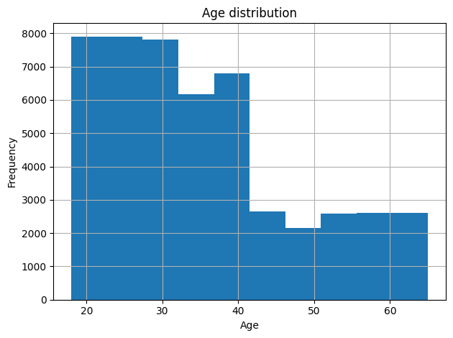
Which age has most users?
Most users are between the age of 17-32.
This means more sensitization should be done among the aged.

Slide 6
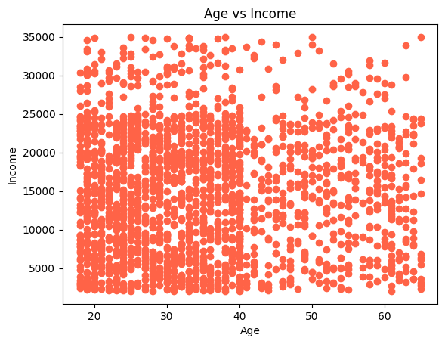
Why the aged have the least market?
The aged earn less income hence there should be an incentive made for it to be affordable to them.

Slide 7
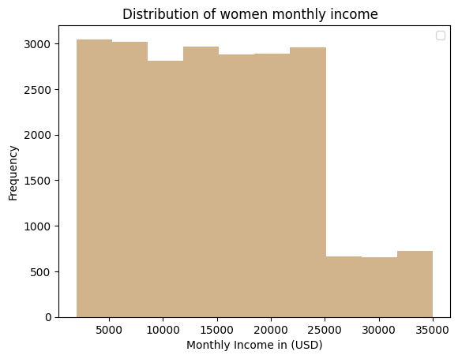
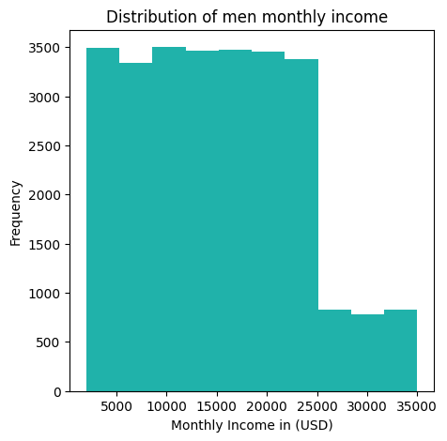
Who earns more?

Slide 8
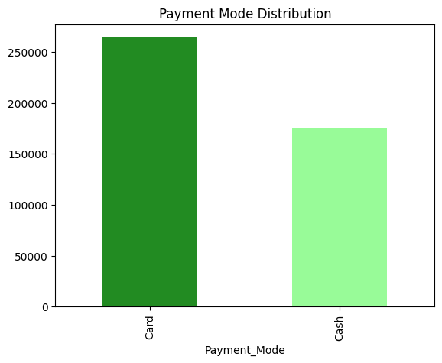
Approach
Most people prefer cashless transfer, hence there should be a budget for gadgets provision.
However, drivers should be provided with cash for change.

Slide 9
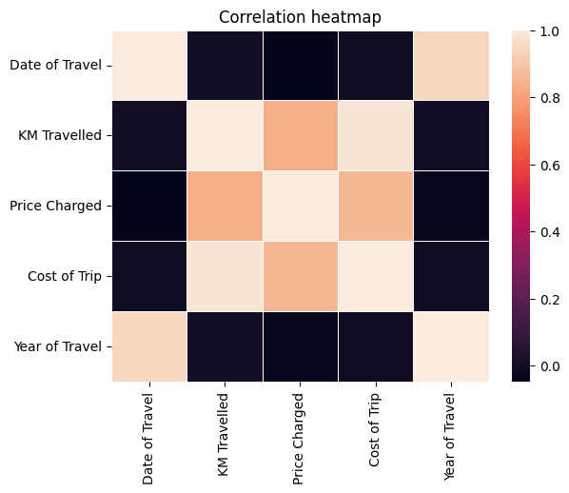
Correlation
1 (brightest) means high correlation whole 0 (darkest) means low correlation.

Slide 10
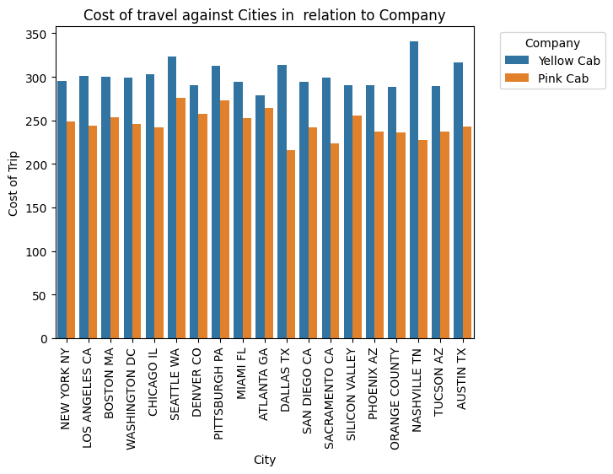
Cost of travel
Pink cab is cheaper than yellow cab. However, it is more stable.

Slide 11
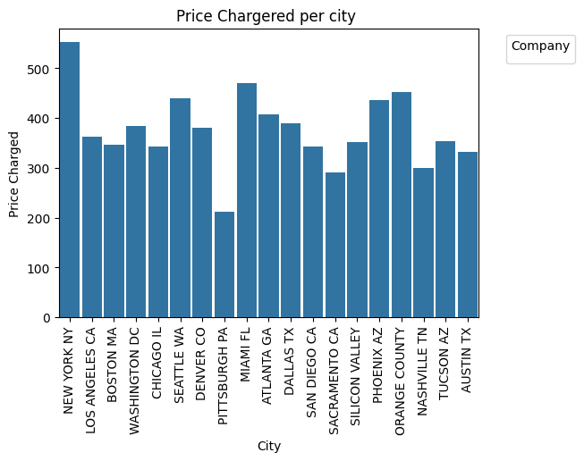
Price per city
New York looks expensive while Pittisburgh PA seems very cheap compared to the rest.

Slide 12
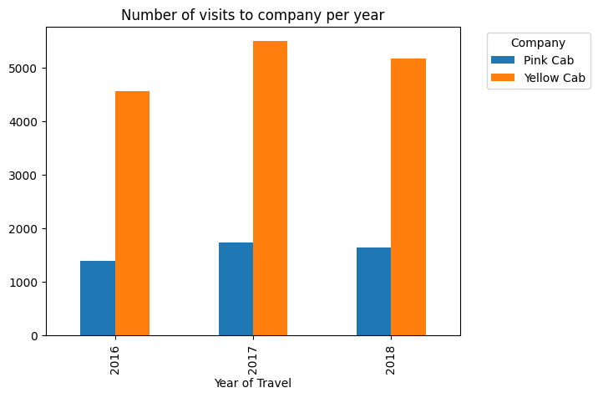
Number of visits per year
Fairly stable although it’s very low for company Pink

Slide 13
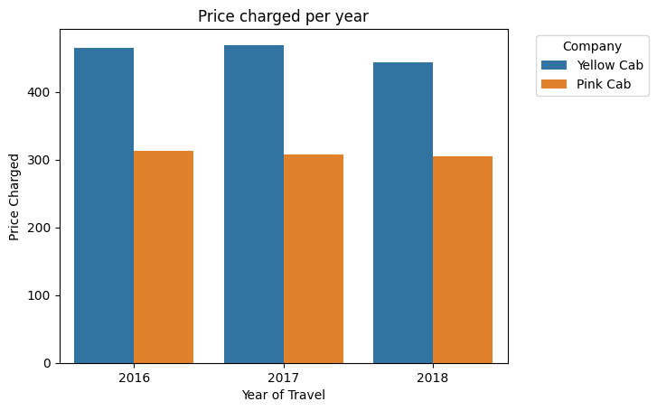
Price charged per year
It’s stable but low for Yellow Cab.
That’s why they have highest number of visits per year.

Slide 14

Summary
NB: Most of the summary was done on the EDA.
Recommendations
New York requires a lot of service providing facilities due to its large market.
Cities like Phoenix AZ, Tucson, Nashville and Pittsburgh PA have the lowest number of users hence there should huge advertisements implemented.
There should be product sensitization among the aged.
Provision of gadgets for money transfer through card.
Continuation of price stability.

Slide 15

kiturmark@gmail.com
Thank You

